Slide 1
3D Flappy Bird
2016 Computer Graphics Final Project

Slide 2
Introduction
01
What are we going to talk about Flappy Bird?
Introduction of Change in Views
Introduction to Game Modelling
Introduction to Game Add-ons
Introduction to Text Display API
Introduction to Scoring System
Introduction to Libraries & API

Slide 3
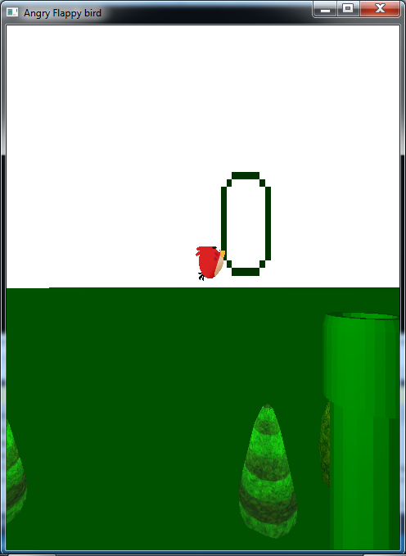
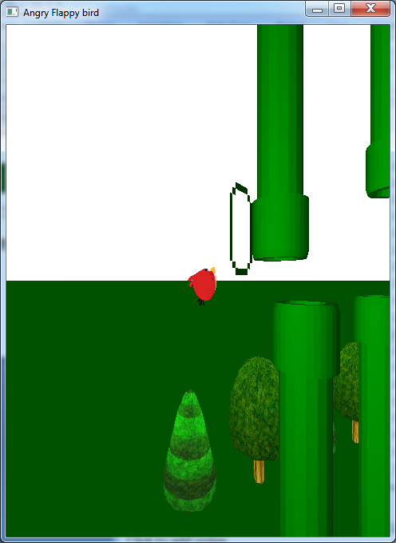
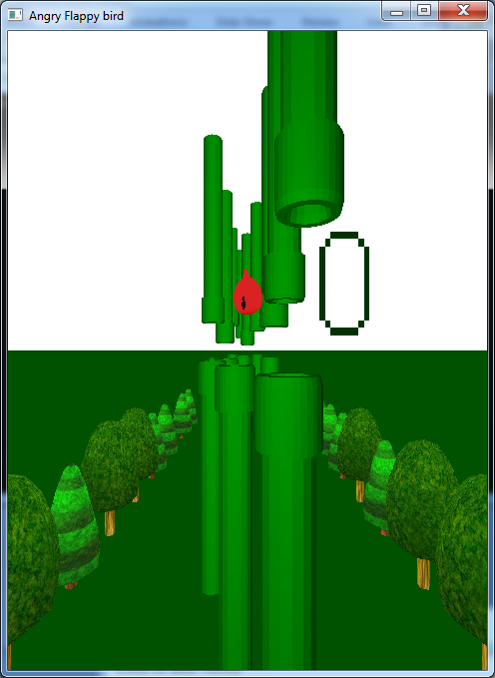
Change In Views
02
Introduction to the viewport
Perspective Change
Achieved through change in eyex, eyey, eyez in gluPerspective()
Implemented switching back and forth between 2D-ish and 3D perspective

Slide 4
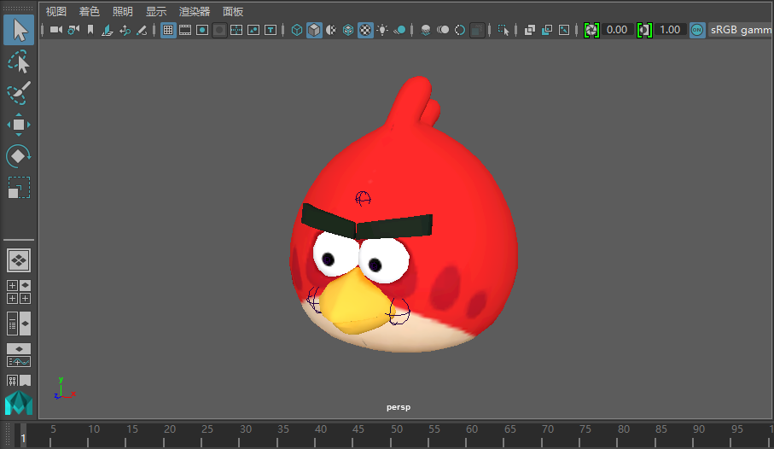
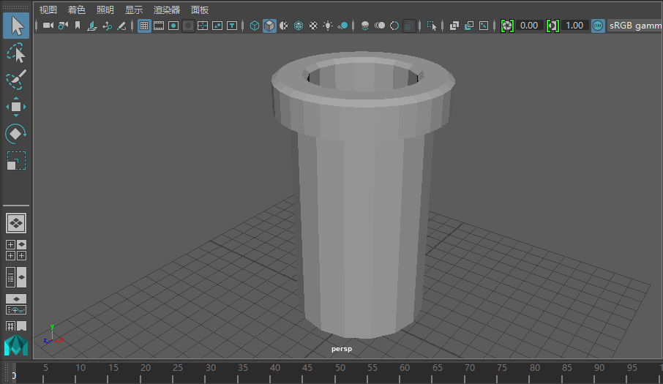
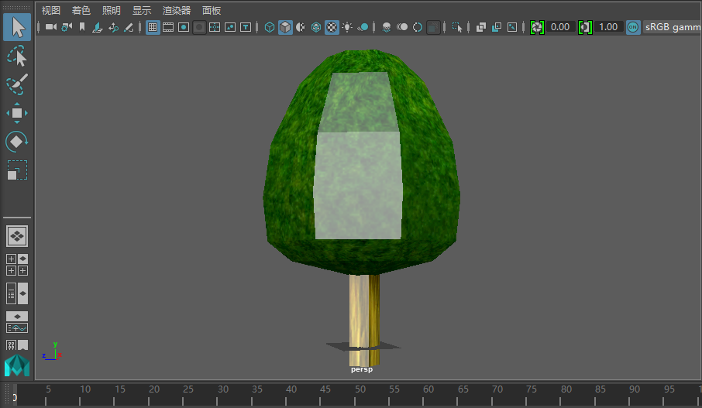
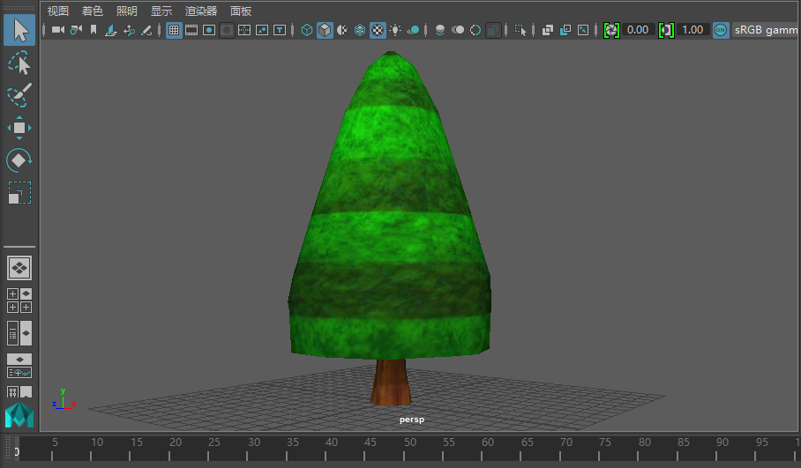
Game Modelling
03
Introduction to Game modelling
Credits to 陈建宇 in contributing to modelling of each 3D models
Referenced from sites: TF3DM, TheVG resource, CGTrader
Spend most of the time figuring out obj, mtl parser and texture mapping

Slide 5
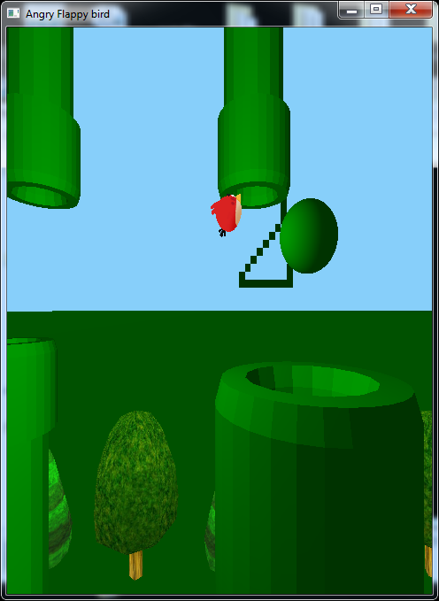
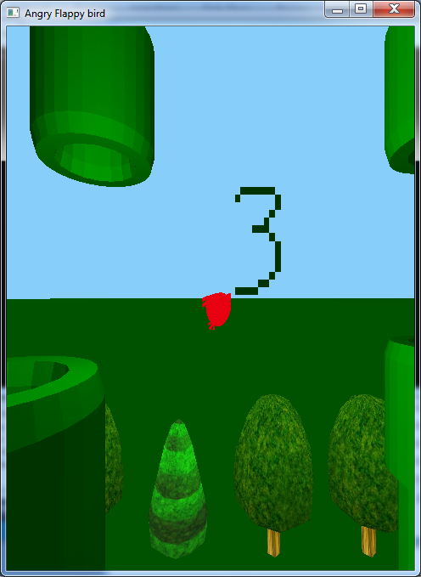
Some Game Add-ons
04
Introduction to game add-ons
Invincible buff
Switching BGM through PlaySound() API
Change in bird’s texture
Implemented by shutting off collision detection

Slide 6

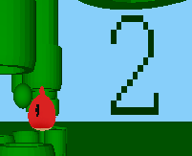

Text Display API
05
Introduction to Text Display API
Credits to 王海容 for building the text display API
Implemented by recording the dot matrix of each text
Read the dot matrix and render accordingly to the matrix

Slide 7
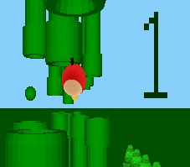
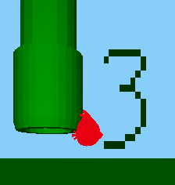
Scoring System
06
Introduction to the Scoring system
Scoring System
If(dist(bird.z, tube.z) < 0.1) then score++
Current score displays next to the bird

Slide 8

Libraries & API
07
Introduction to the Libraries and APIs
Background Music
Implemented by Win32 API
Simple, but naive
Does not support multimedia

Slide 9
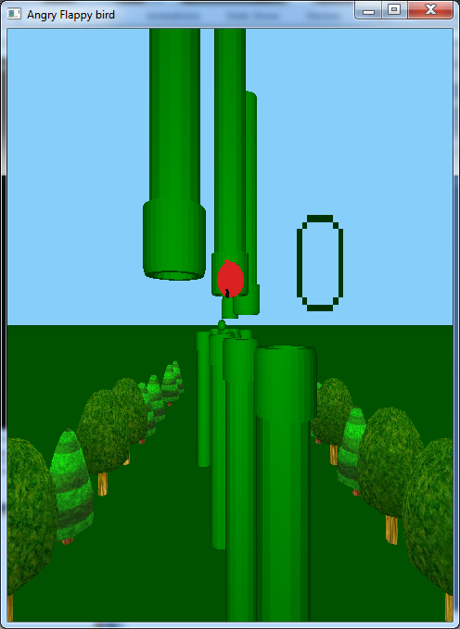
Final Version of 3D Flappy Bird
08
Introduction to the final version of our 3D flappy bird
Analysis
Randomization Algorithm
Huge amount of randomization algorithms are applied
The positions of trees(left or right)
The positions of tubes(top or bottom)
The state of trees(Decide which 3D model to use)
The spawn of invincible buff

Slide 10
Thank You
Looking forward to our 3D Flappy Bird

